Slide 1


Slide 2
Big O, Big Θ, Big Ω
&
Space Complexity

Slide 3
Big O
Asymptotic complexity in the worst case
Big O notation characterises functions by the growth rates of their time and space requirements as the input size grows asymptotically towards infinity.
It does this by considering the number of times the base operation will run in the worst case.
By doing this, we know that the algorithm’s time complexity will never exceed this running time.
It’s not just about specifying an upper bound though (where we specify an arbitrary high order run time) – it’s about characterising the growth of the algorithm as the input size grows too.
Worst case growth analysis is therefore the most common analysis of an algorithm.

Slide 4
Big Ω
Asymptotic complexity in the best case
Big Ω notation is used to put a lower limit on how long an algorithm will run for.
It does this by considering the number of times the base operation will run in the best case.
The best case refers to the type and configuration of input, NOT a minimum input size (e.g. we wouldn’t consider an input size of 1 as a best case)
By doing this, we know that the algorithm’s time complexity will never be better than this running time.
The best case is not always Ω(1). Consider finding the maximum value in a list, merge sort, quick sort etc.

Slide 5
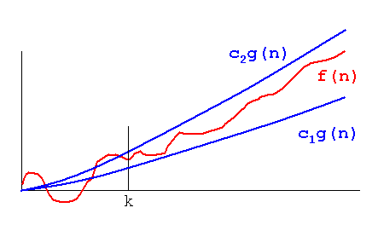
Big Θ
When the worst case and best case are the same
If it just so happens that the complexity of the best case and the complexity of the worst case scenario are the same size (ie: O(g(n) = Ω(g(n))), we have a special situation.
When this happens, rather than state the best and worst case, we state that the complexity is Θ(g(n)) which implies that the best and worst case are the same size.

Slide 6
Space Complexity
The final frontier

Slide 7
Space Complexity
Space complexity is a measure of the amount of memory an algorithm requires in order to complete its operation.
We can calculate the space complexity of an algorithm by adding up all of the space required to store variables, constants and structures (ie: arrays, lists, etc.).

Slide 8
Examples

Slide 9
Example 1
Algorithm 1
Input: A non-negative integer n.
S = 0
for i = 1 to i = n
S = S + i*i
return S

Slide 10
Example 2
Algorithm 2
Input: An array A[ ] consisting of n integer elements.
Sum = 0
for i = 0 to i = n - 1
Sum = Sum + A[ i ]
return Sum

Slide 11
Example 3
Algorithm 3
Input: A n x n sized matrix A[ ] of real numbers
for i = 0 to i = n - 2
for j = i + 1 to j = n -1
If A[ i , j ] =! A [ j , i ]
return false
return true

Slide 12
Example 4
Algorithm 4
Input: A non-negative integer n
Total = 1
if n = 0
return 1
else
for i = 1 to i = n
Total = Total* n
return Total

Slide 13
Example 5
Algorithm F ( n )
Input: A non-negative integer n
If n = 0
return 1
else
Return F(n - 1) * n

Slide 14
Space and Time Complexity Tradeoffs
Counting Sort vs Quick Sort
Remember the sort123() function?
What if we extended this to all numbers between 0 and 9?
Notes:
Representing Binary Trees as Arrays
Counting Sort vs Quick Sort

Slide 15
Space and Time Complexity Tradeoffs
Unrolling Loops
#loop, less code, slower
for i in range(3):
print(i)
#unrolled loop, more code, faster
print(0)
print(1)
print(2)
Notes:
Representing Binary Trees as Arrays
Counting Sort vs Quick Sort

Slide 16
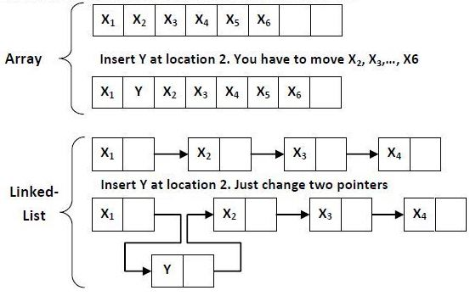
Space and Time Complexity Tradeoffs
Arrays vs Lists
Notes:
Representing Binary Trees as Arrays
Counting Sort vs Quick Sort

Slide 17
Activity

Slide 18
Finding the max sum of contiguous subarrays of size k
Given an array of integers and an integer k, find the maximum of all sums of contiguous subarrays of size k.
E.g:
For the input = [7, 1, 3, 3, 4, 5, 2, 3, 6], k = 3
Output = 12
Write an algorithm that can find the maximum of all sums of contiguous subarrays of size k.
Once done, share your algorithm with a friend and analyse each other’s algorithms to determine space and time complexity and try to identify ways to improve each algorithm.

Slide 19
Finding the contiguous subarray with the largest sum
Given a non-empty, one-dimensional array, find the contiguous sub-array that has the largest sum.
E.g:
Consider the array [ -2,-3, 4, -1, -2, 1, 5, -3].
The contiguous sub-array of [4,-1,-2,1,5] from this array has the largest sum which is equal to 7.
Write an algorithm that can find the contiguous subarray with the largest sum for any given one-dimensional array.
Once done, share your algorithm with a friend and analyse each other’s algorithms to determine space and time complexity and try to identify ways to improve each algorithm.

